Slide 1

Seeding an express APP

Slide 2
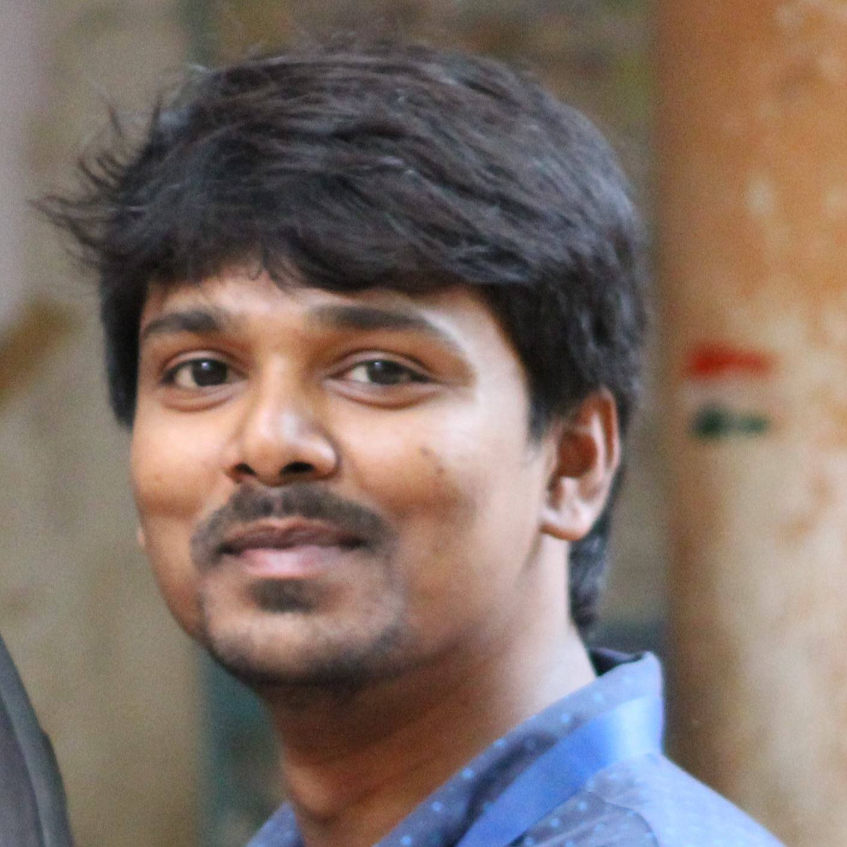
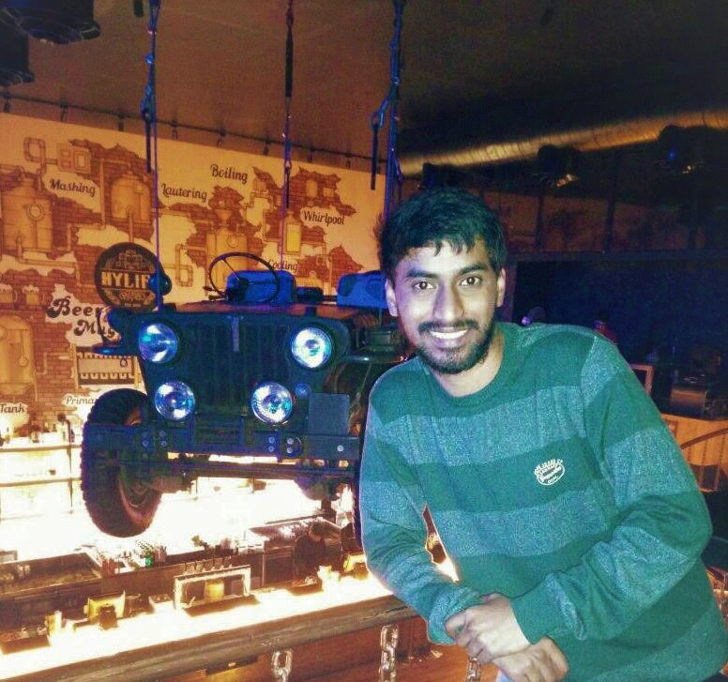

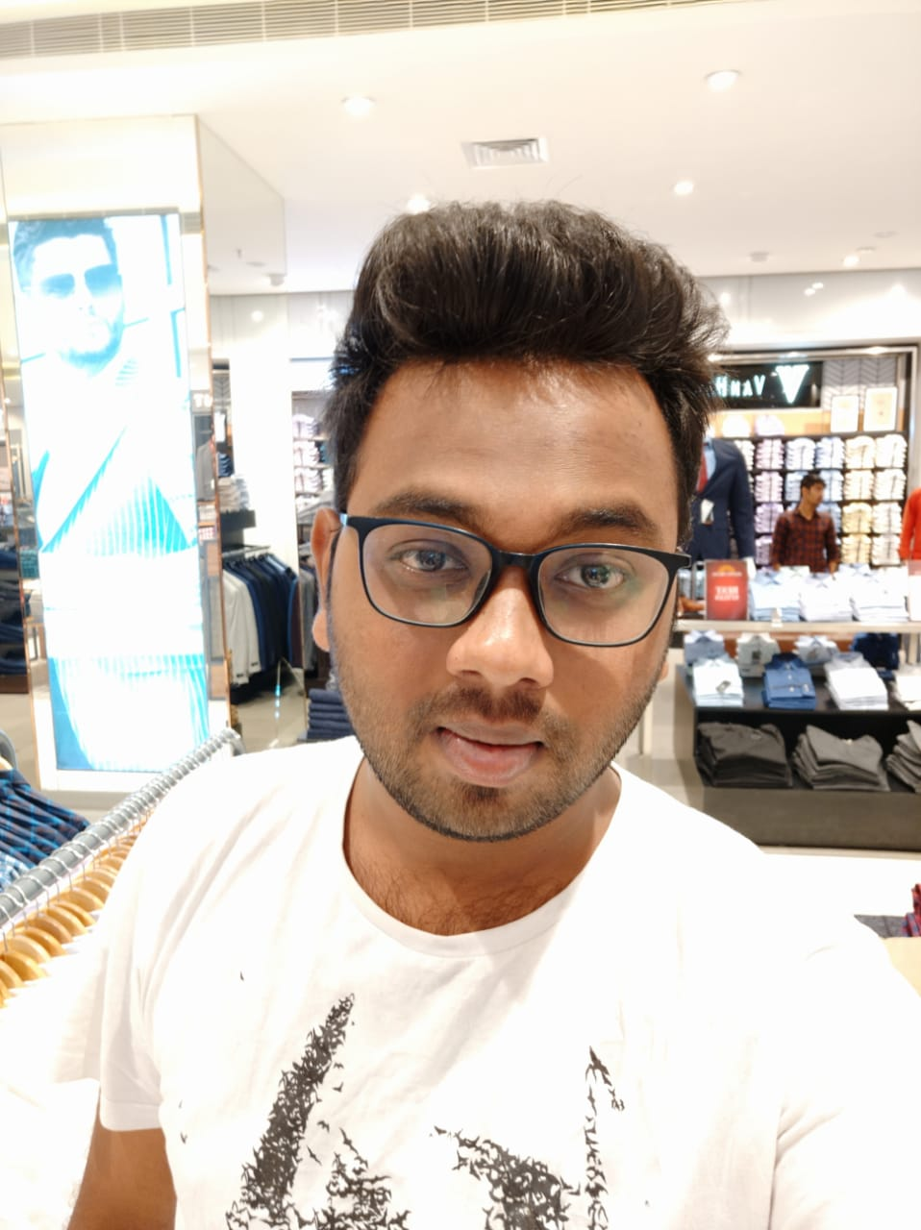
Leela Krishna
VenkataSandeep
Anvesh
Pavan

Slide 3

Outcomes
VenkataSandeep

Slide 4
Outcomes
Passing a value
Passing objects
Getting data from DB
Inserting data into DB
VenkataSandeep

Slide 5

Passing a value
VenkataSandeep

Slide 6
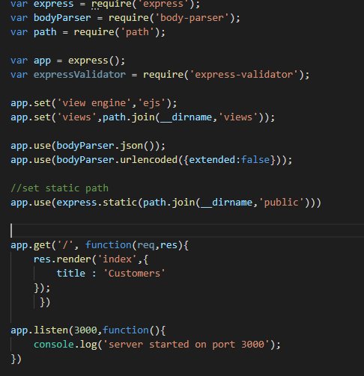
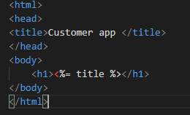
VenkataSandeep

Slide 7
Passing objects
Anvesh

Slide 8
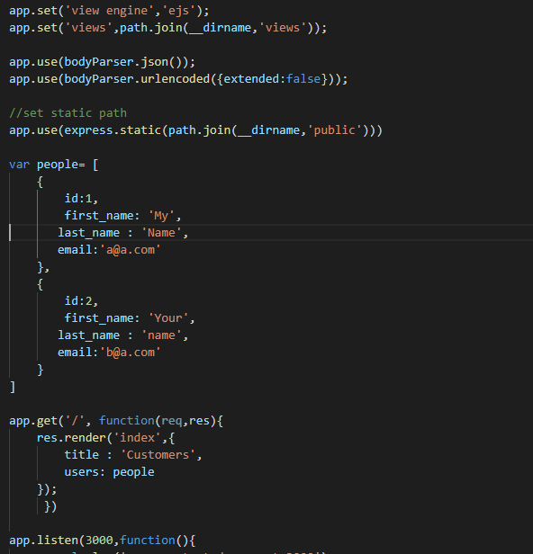
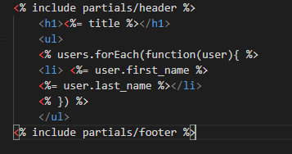
Anvesh

Slide 9
Getting data from DB
Pavan

Slide 10
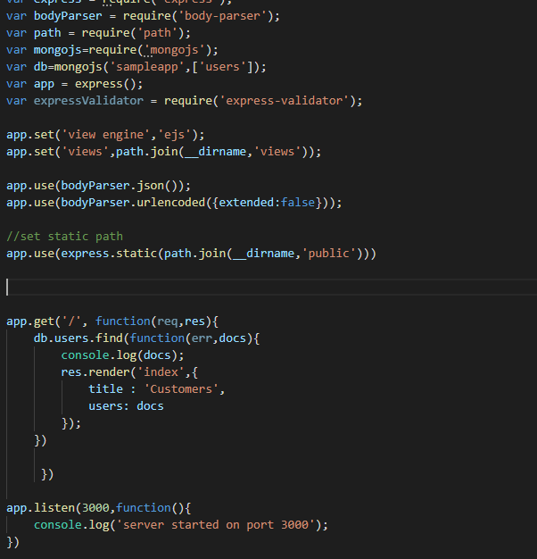
Retrieving array of objects from DB
Pavan

Slide 11
Inserting data into DB
Leela

Slide 12
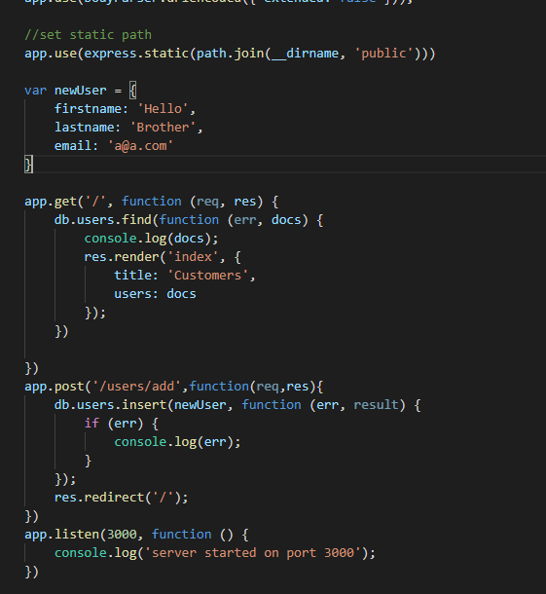
Inserting object into DB
Leela

Slide 13
Any Questions ???

Slide 14
Thank You ☺ ☺ ☺

